Slide 1
AI Agent For Digital Financial Literacy
CAPSTONE PROJECT
Presented By
Student Name : Varadaraju N Y
College Name & Department : Government Engineering College, Ramanagara ( B.E )

Slide 2
OUTLINE
Problem Statement
Technology used
Wow factor
End users
Result
Conclusion
Git-hub Link
Future scope
IBM Certifications

Slide 3
PROBLEM STATEMENT
Many individuals and families face a significant financial literacy gap, struggling to manage personal finances, understand complex financial products, and create effective budgets.
This lack of accessible knowledge leads to tangible negative consequences, including poor financial decision-making, increased debt, and missed opportunities for long-term wealth building.
Current methods for financial management, such as manual expense tracking and consulting traditional advisors, are often time-consuming, inefficient, and costly.
There is a critical need for an automated, intelligent, and readily available solution that can provide personalized financial guidance and support.

Slide 4
TECHNOLOGY USED
IBM cloud lite services
Natural Language Processing (NLP)
Retrieval Augmented Generation (RAG)
IBM Granite model

Slide 5
IBM CLOUD SERVICES USED
IBM Cloud Watsonx AI Studio
IBM Cloud Watsonx AI runtime
IBM Cloud Agent Lab
IBM Granite foundation model

Slide 6
WOW FACTORS
This agent will democratize financial knowledge, making personalized advice accessible to everyone.
Unique features include:
Personalized Budgeting: Creates and adjusts budgets based on a user's spending habits.
Financial Health Score: Provides a simple, actionable score to help users understand their financial standing.
Investment Insight: Analyzes market data and explains investment options in simple terms.
Real-time Fraud Alerts: Integrates with financial accounts to notify users of unusual activity.
Goal-Based Planning: Helps users set and track progress toward financial goals like saving for a down payment or retirement.

Slide 7
END USERS
Aspiring Professionals and Students: Individuals new to managing their finances who need foundational guidance on budgeting, saving, and understanding their first paychecks.
Families and Households: Users focused on long-term financial planning, managing household budgets, and working toward shared goals like buying a home or saving for a child's education.
Self-Directed Investors: Individuals seeking to enhance their financial literacy, explore investment strategies, and gain insights into complex financial products in an accessible way.
Small Business Owners: Entrepreneurs who require a streamlined solution for tracking business expenses and managing cash flow to ensure financial stability and growth.

Slide 8
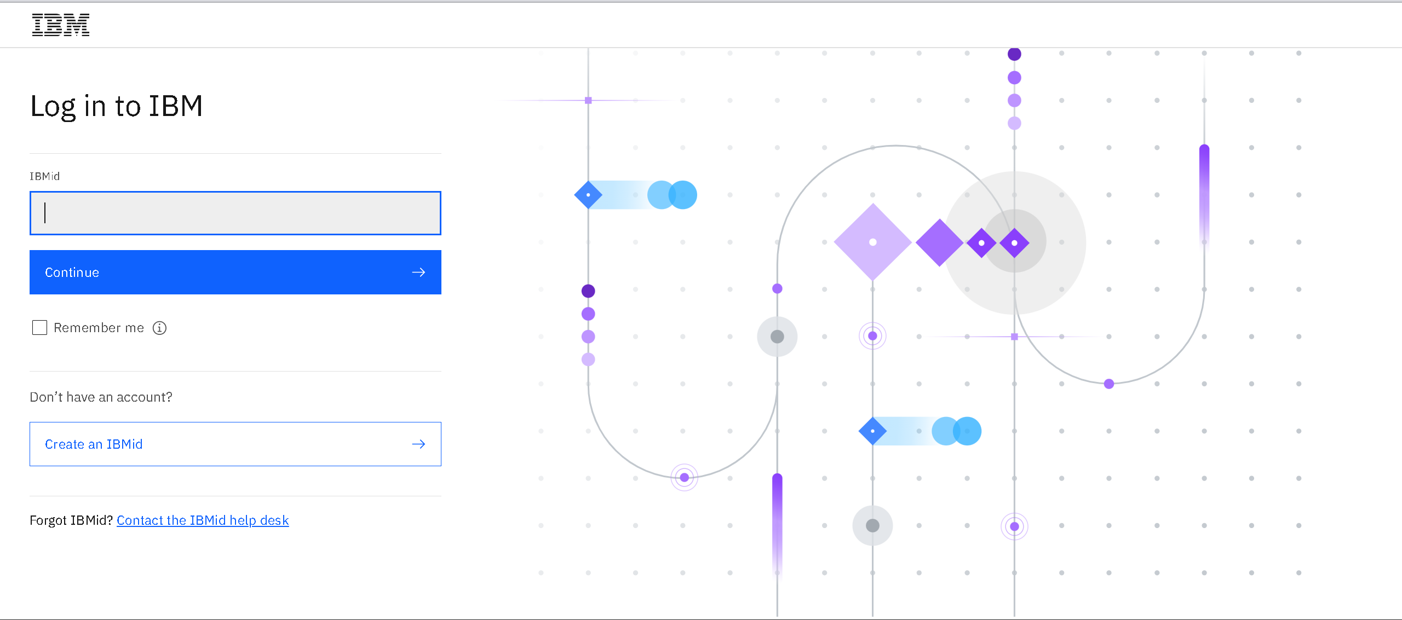
STEP 1: Login to IBM Cloud

Slide 9
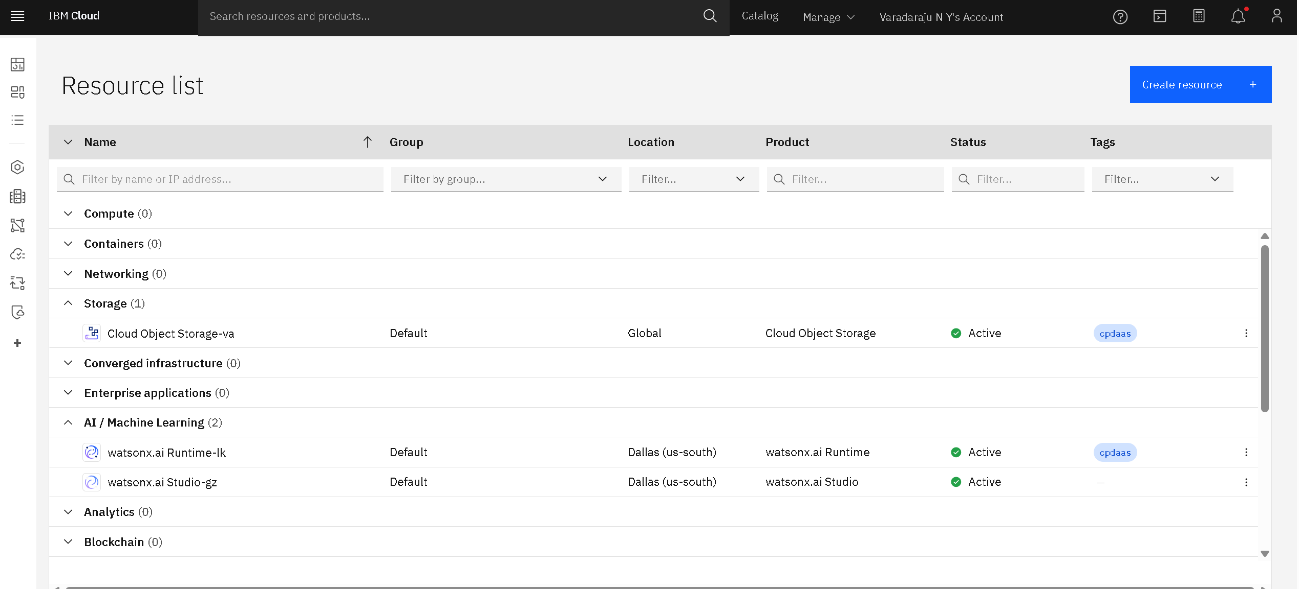
STEP 2: Set Up the Required Resources for AI Agent Project

Slide 10
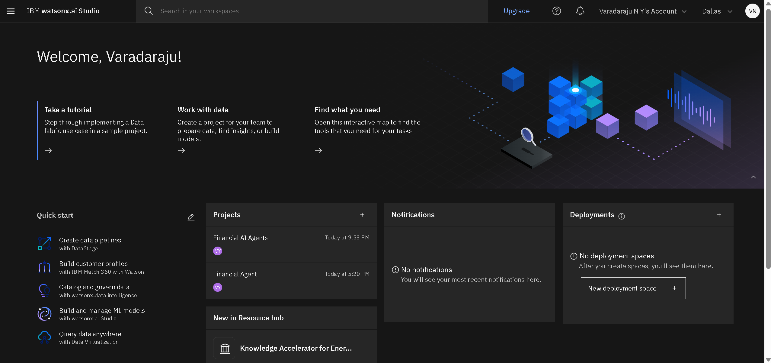
STEP 3: Open IBM watsonx.ai Studio

Slide 11
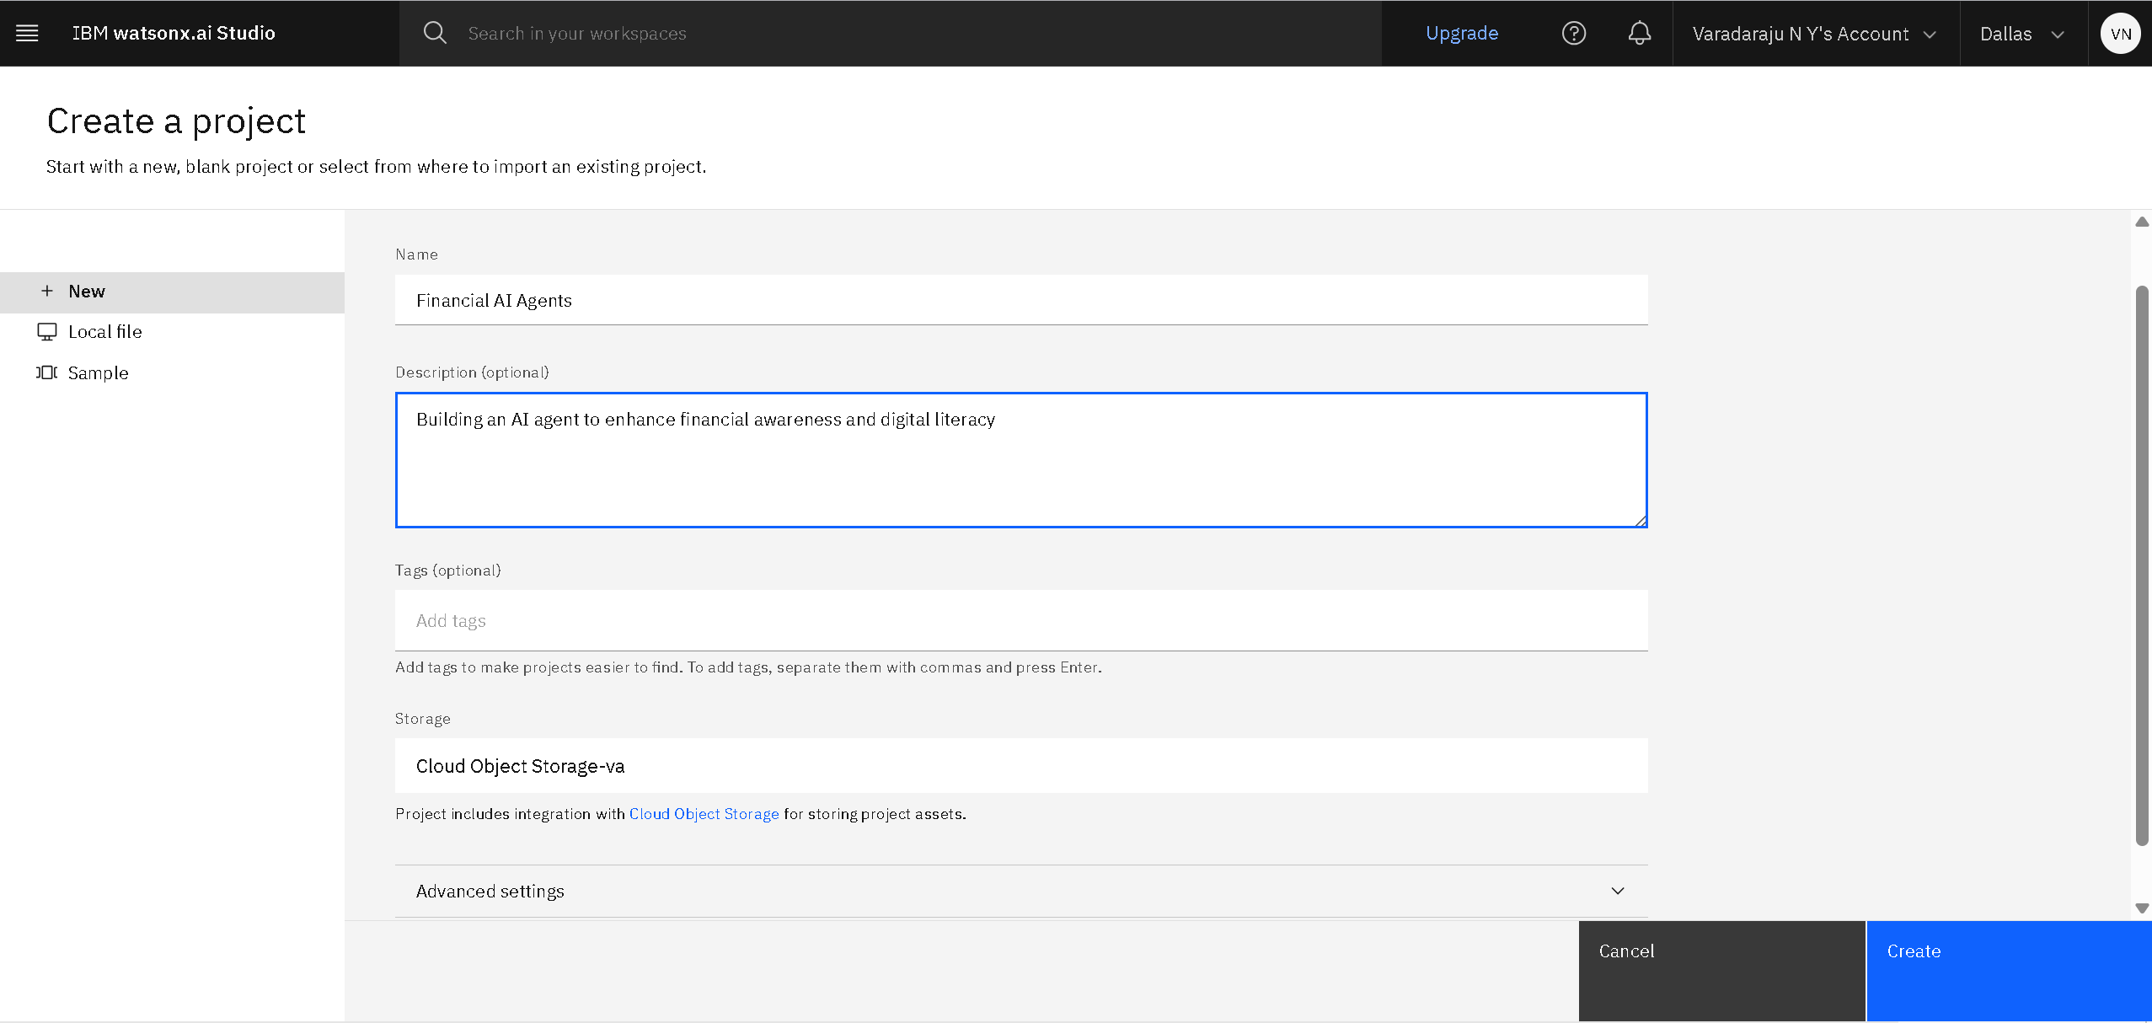
STEP 4: Create AI Agent Project in IBM watsonx.ai Studio

Slide 12
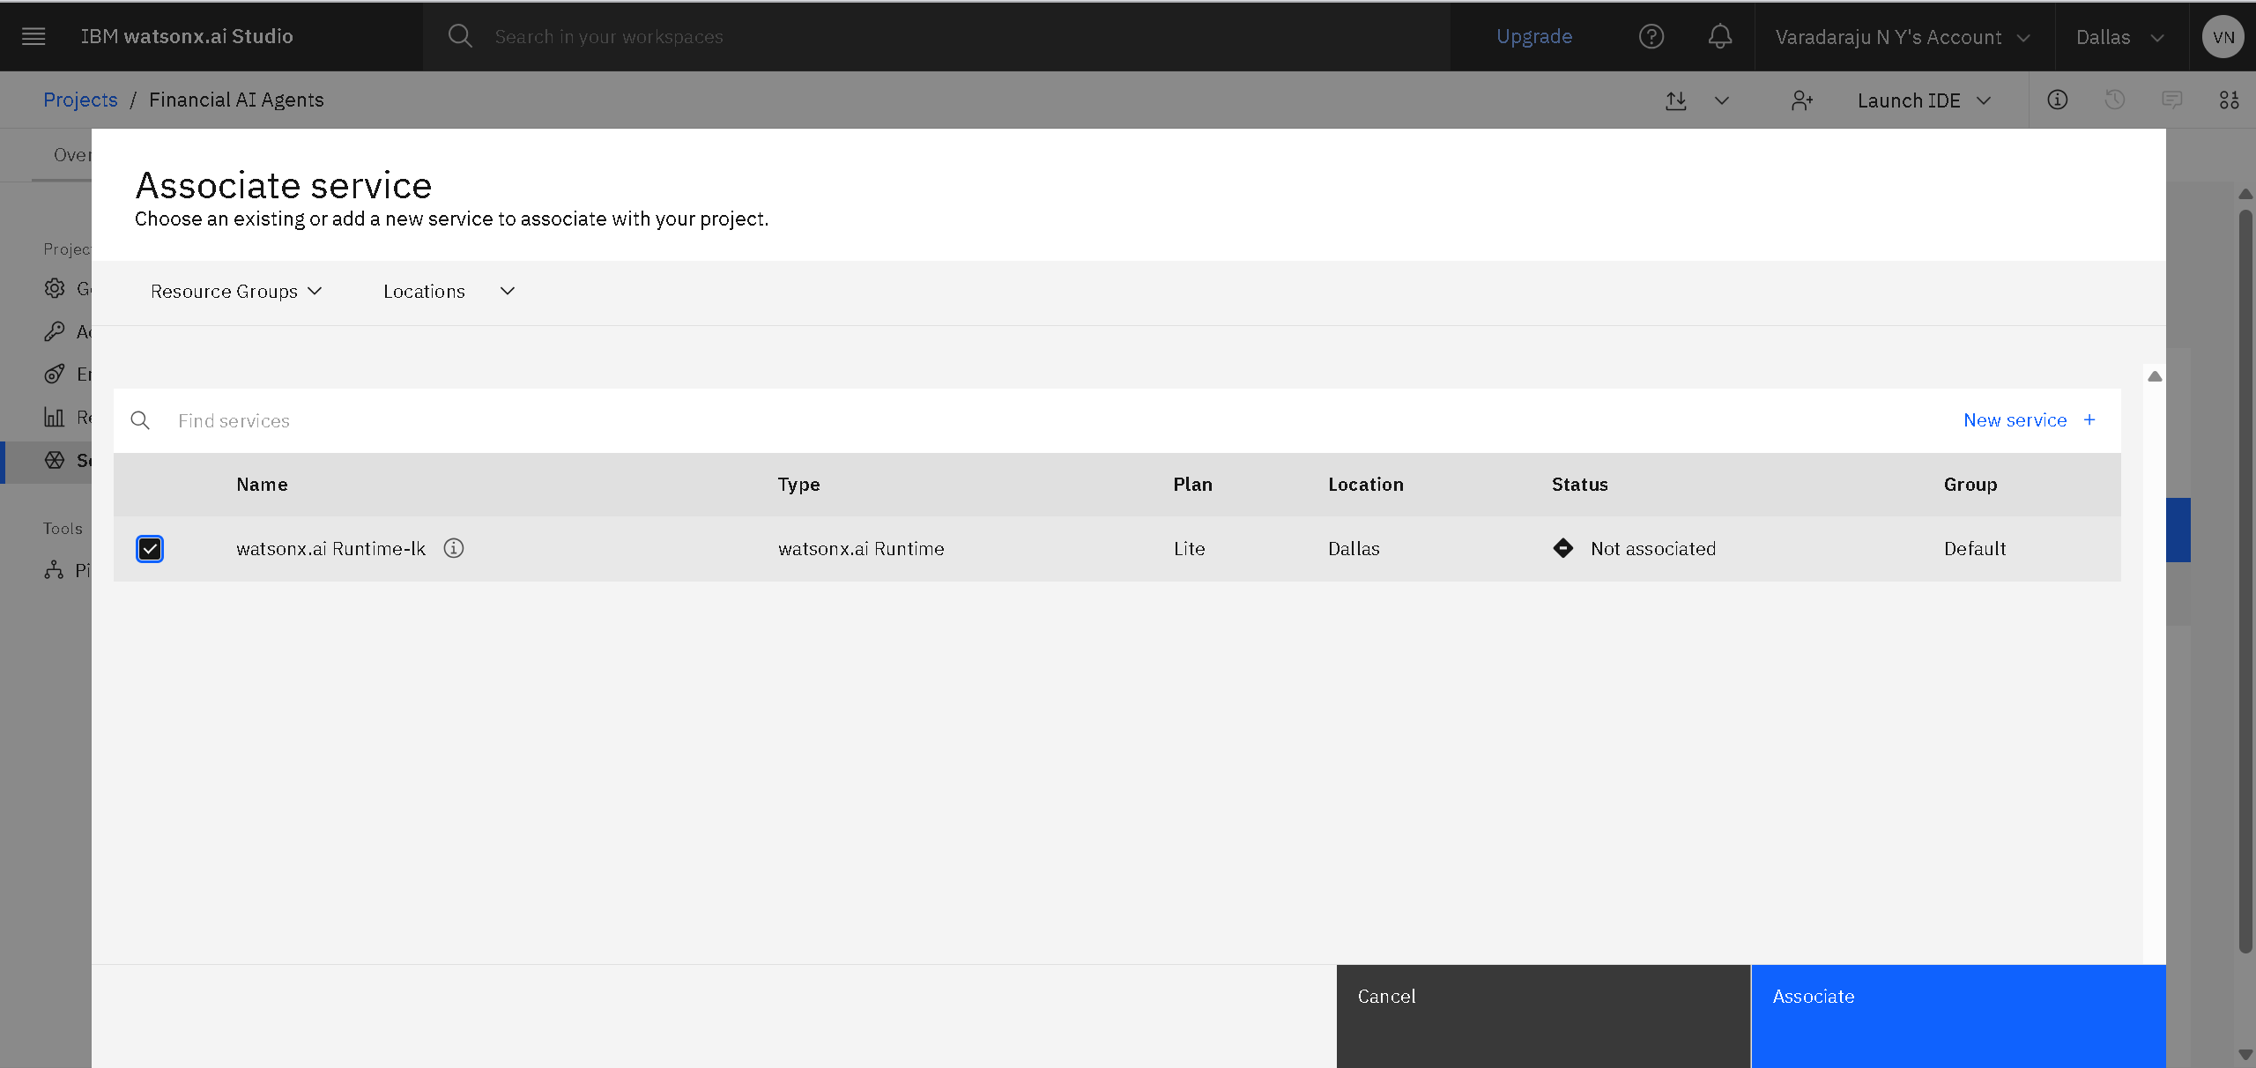
STEP 5: Create Associate Service for AI Agent Project

Slide 13
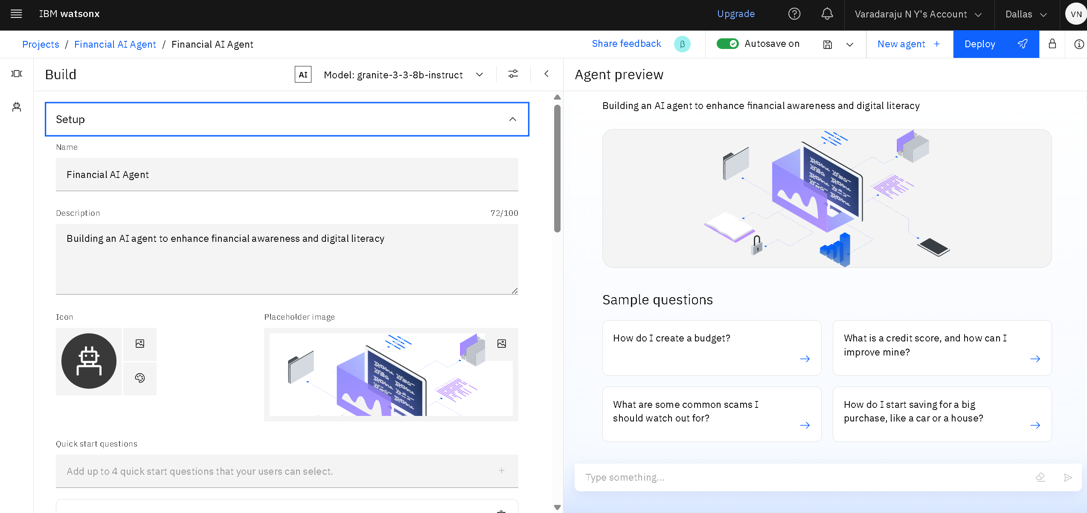
STEP 6: Build and Setup for AI Agent Project in IBM watsonx.ai Studio

Slide 14
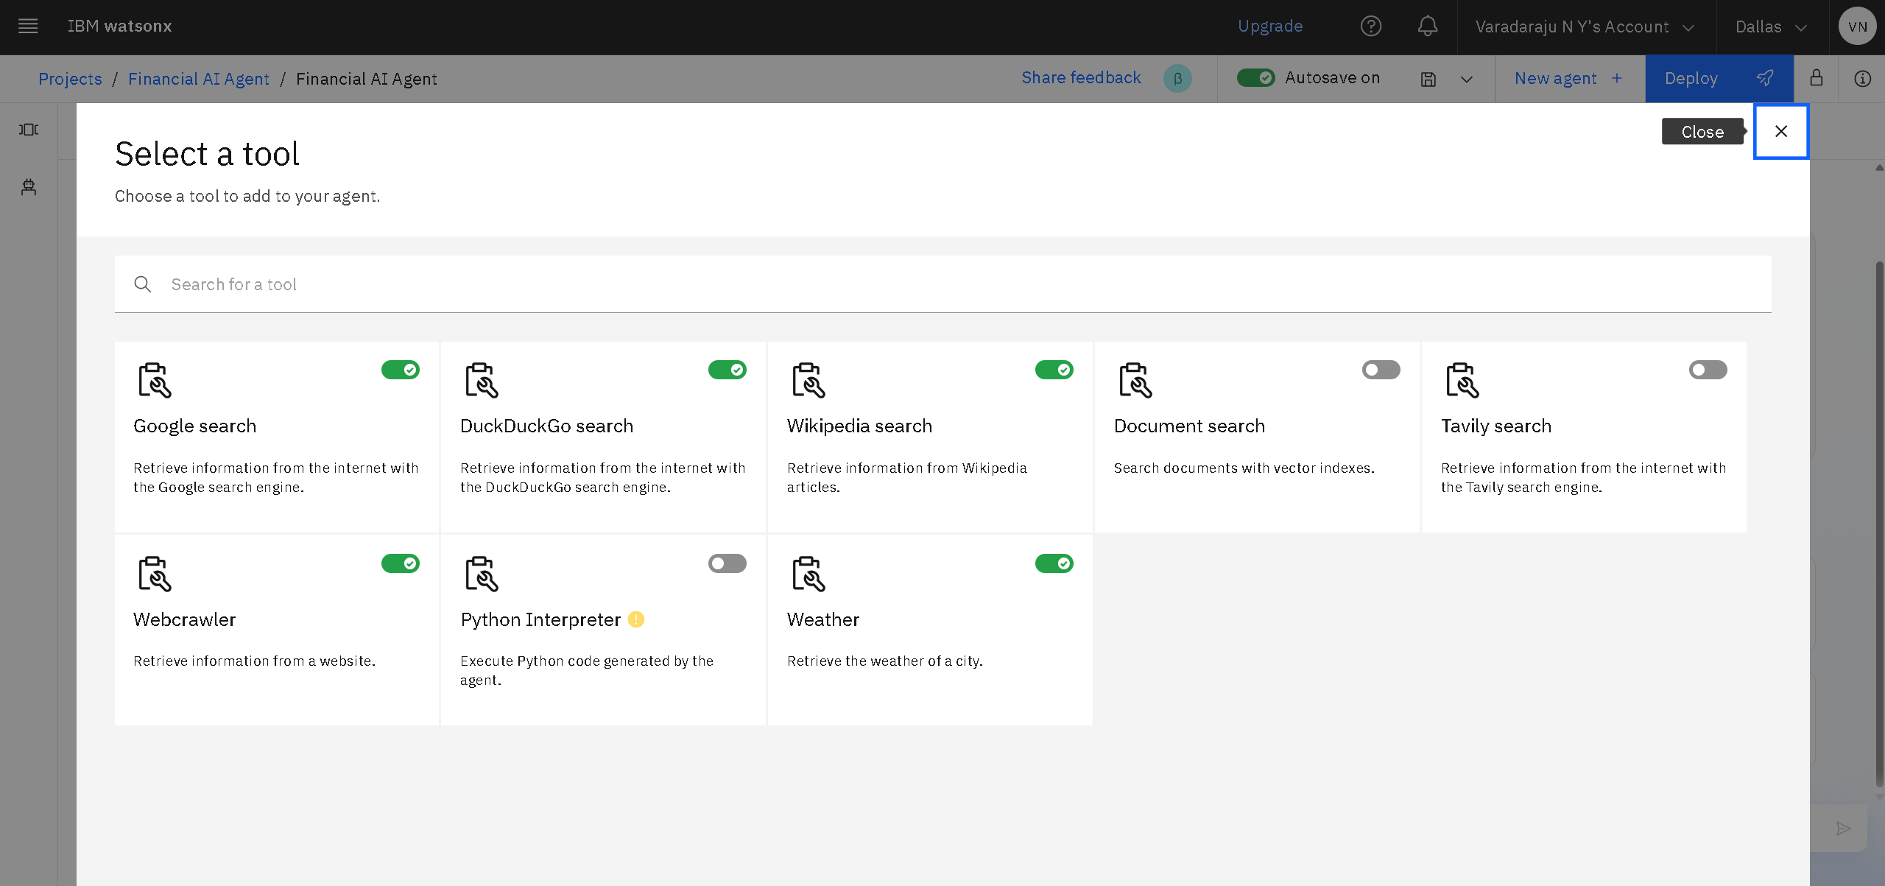
STEP 7: Add Tools for AI Agent Project in IBM watsonx.ai Studio

Slide 15
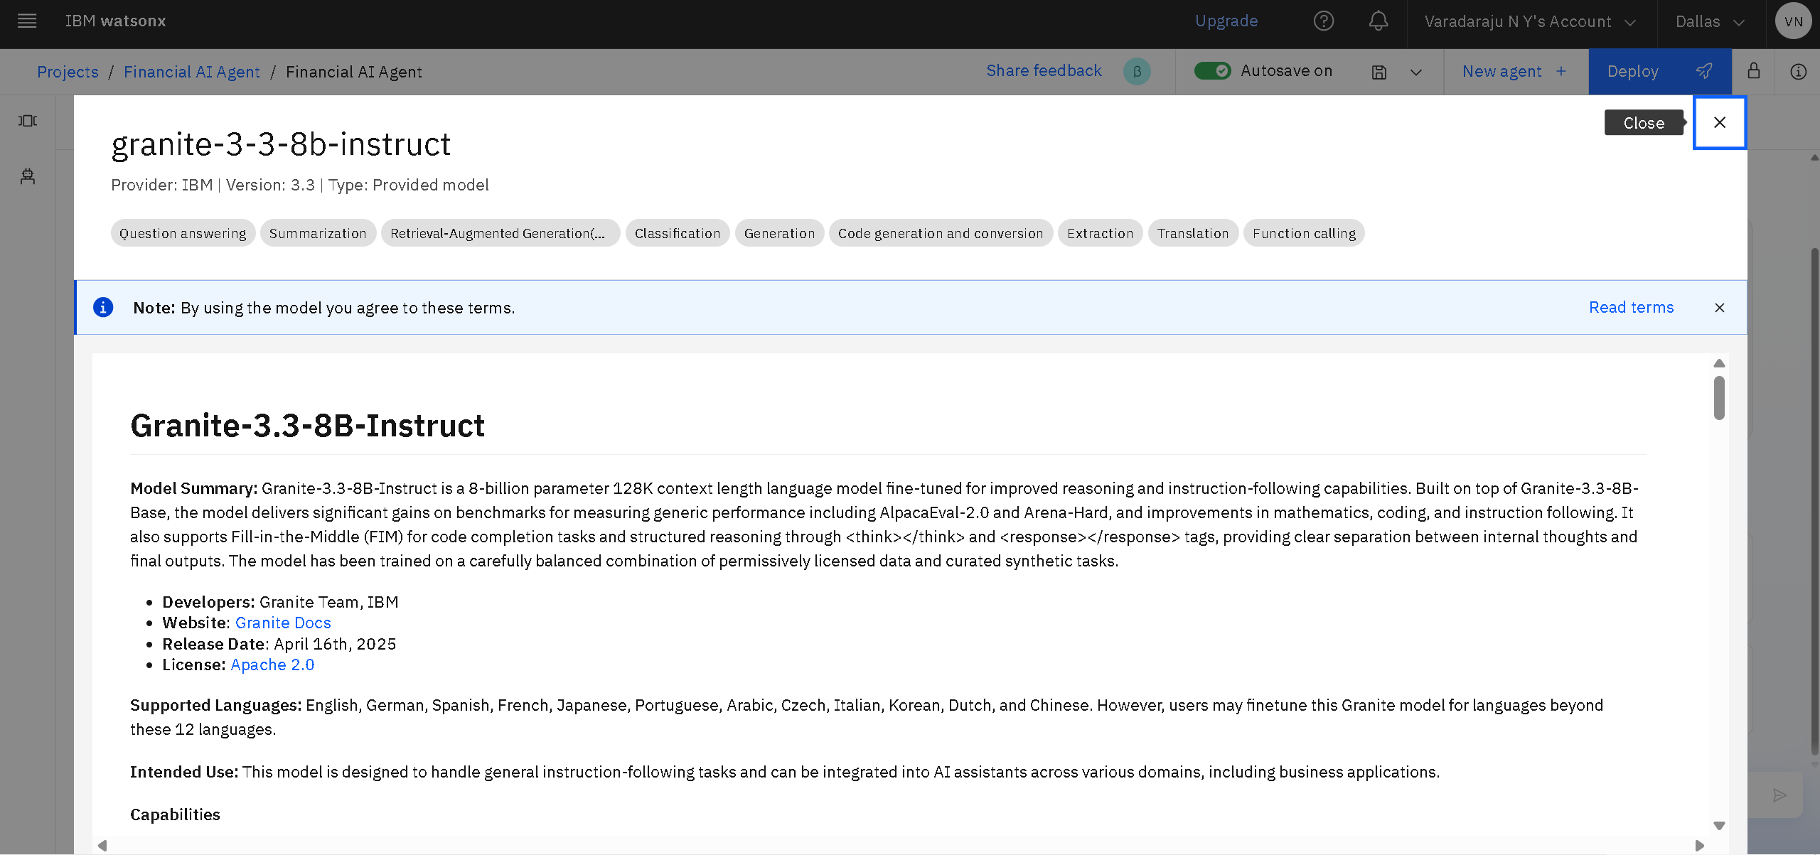
STEP 8: Add Granite Model for AI Agent Project in IBM watsonx.ai Studio

Slide 16
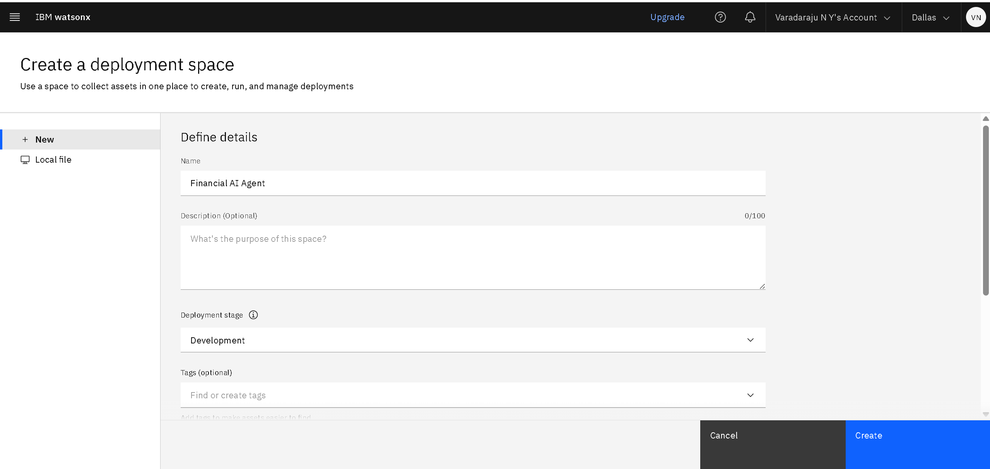
STEP 9: Add Deployment Space for AI Agent Project in IBM watsonx.ai Studio

Slide 17
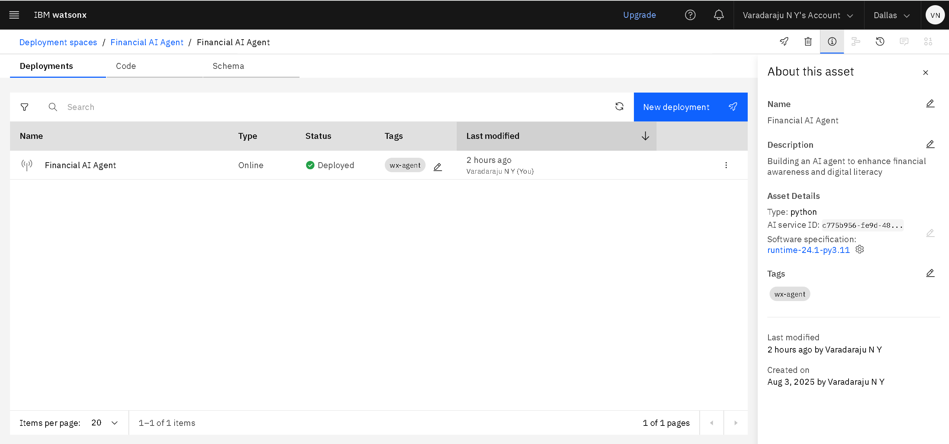
STEP 10: Select Deployment for AI Agent Project in IBM watsonx.ai Studio

Slide 18
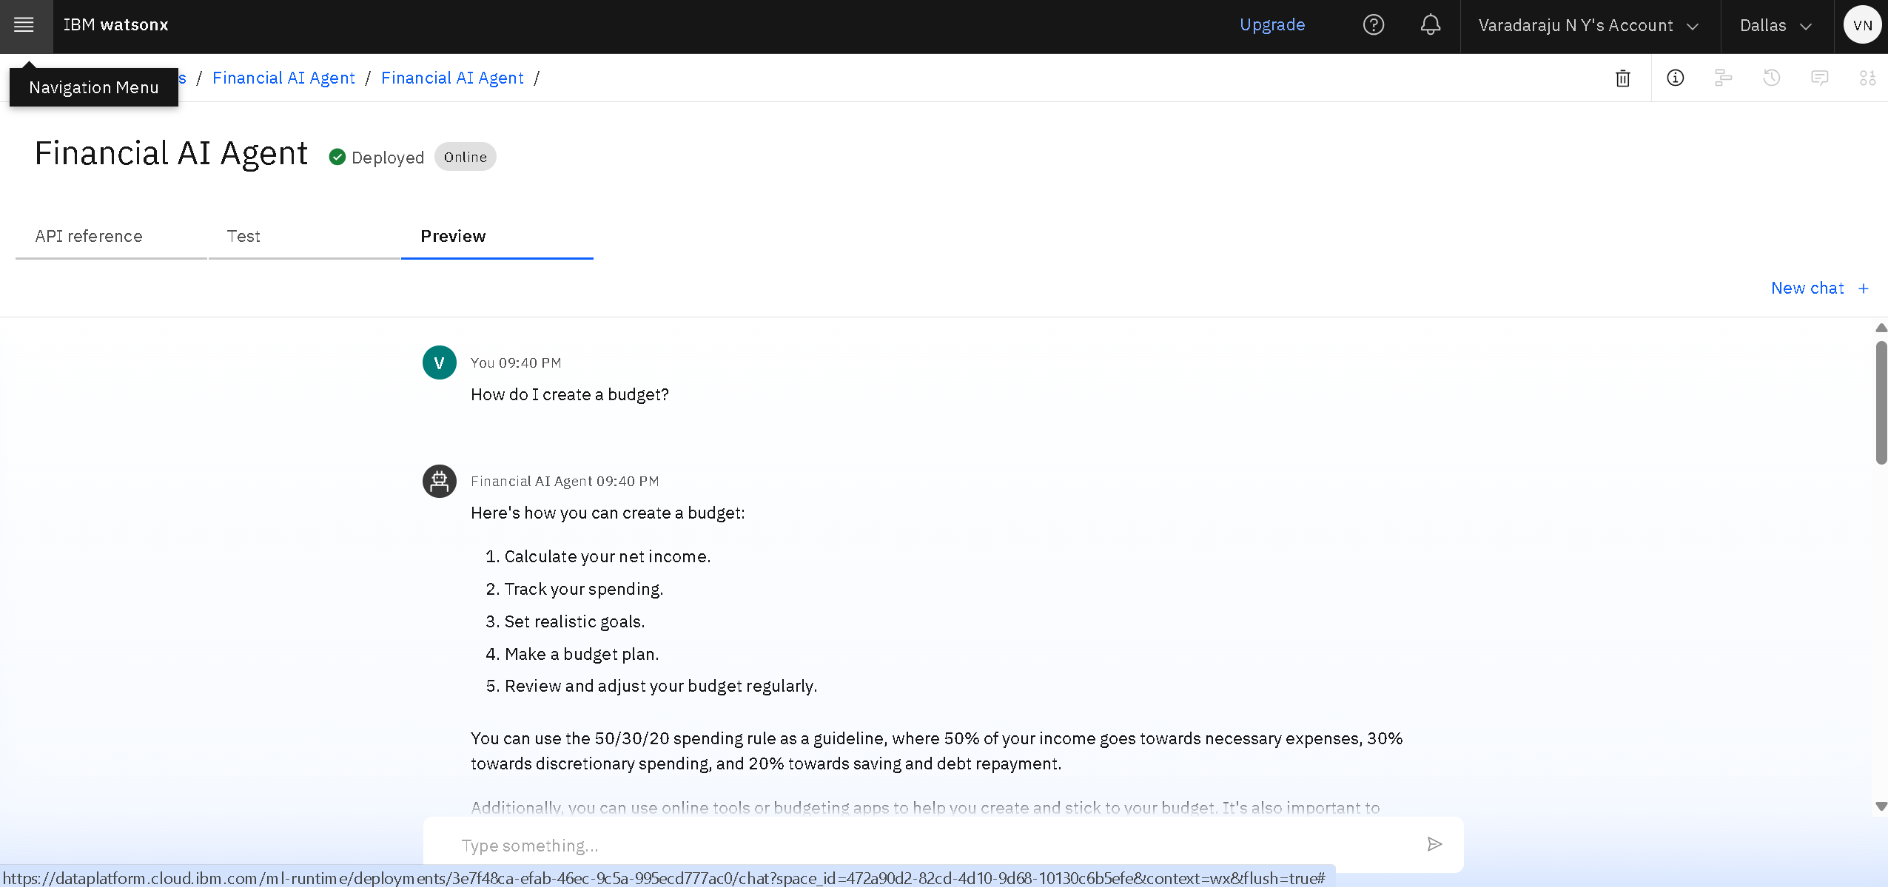
DEPLOYED AGENT RESULTS

Slide 19
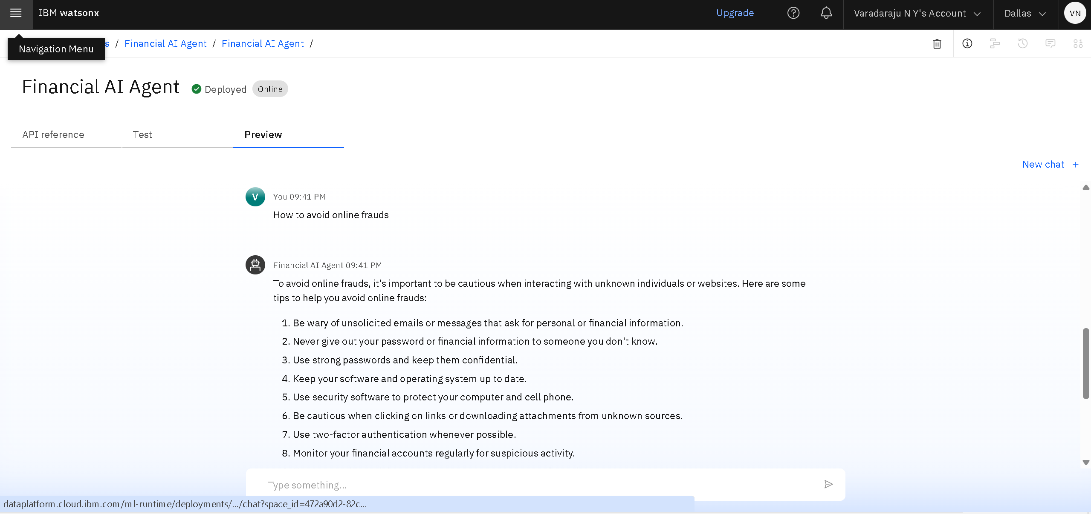
DEPLOYED AGENT RESULTS

Slide 20
CONCLUSION
The AI Financial Literacy Agent successfully enhances efficiency and accessibility by automating complex financial tasks and simplifying key concepts.
By providing instant, personalized advice, the agent empowers individuals and families to make more informed financial decisions, leading to better long-term outcomes.
This project demonstrates the significant potential of AI agents to deliver actionable and accessible knowledge, bridging the gap in financial literacy.

Slide 21
FUTURE SCOPE
Voice-Activated Interface: Develop a voice-activated assistant for hands-free, conversational interaction, making financial management more convenient.
Secure Platform Integration: Implement secure API connections to financial institutions for real-time data analysis and seamless expense tracking.
Advanced Market Intelligence: Integrate real-time market data to provide users with proactive investment insights and alerts tailored to their portfolios.
Expanded Language Support: Extend the agent's capabilities with multilingual support to serve a diverse, global user base.
Automated Tax Preparation: Incorporate AI-powered features to assist users in organizing financial documents and preparing for tax season, reducing manual effort.

Slide 22
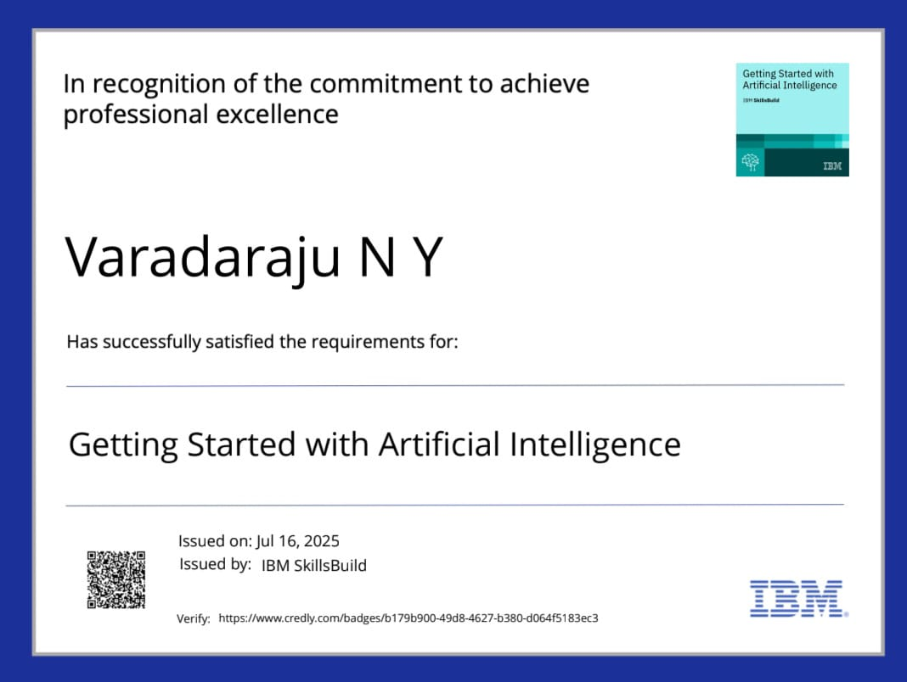
IBM CERTIFICATIONS
Credly Link : https://www.credly.com/badges/130859ac-0d19-4696-9797-41ed9c616f7c/public_url

Slide 23
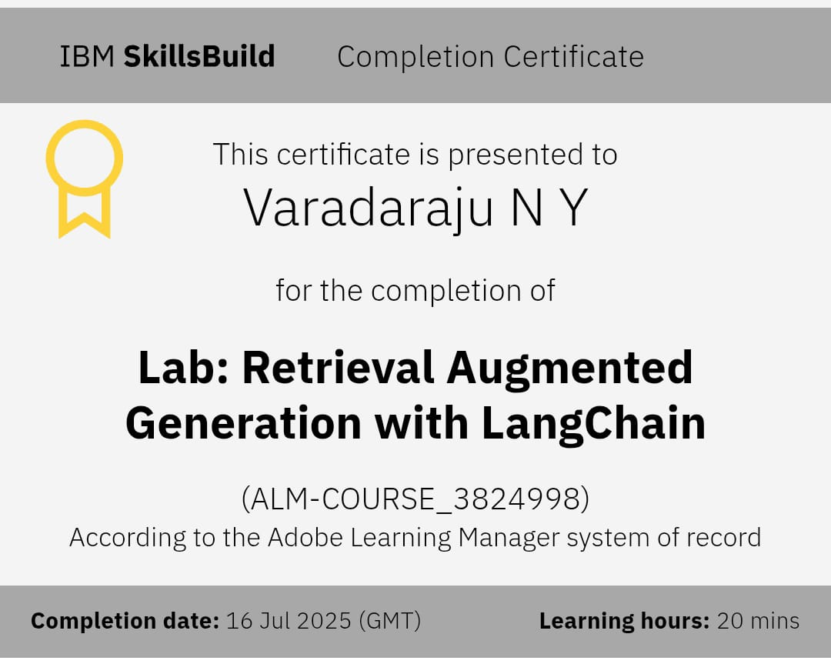
RAG Certificate

Slide 24
GITHUB LINK
GitHub Link :- https://github.com/varadaraju17/AI-Agent-For-Digital-Financial-Literacy

Slide 25
THANK YOU

